Slide 1

Expensify
Pratik Gawand
Sathwik Hegde
Ganesh Dharani
Shenckerr Gollapudi
Info 6150 Final Project
https://expensify-react-client.herokuapp.com/

Slide 2

Purpose
Implementing the Web application to replace the conventional pen and paper approach to note down the expenses
Expensify helps to log the daily expenses categorically
Improves the financial stability over the expenses
Avoids the conflicts due to financial activities
Reduce financial stress

Slide 3
Techstack
Frontend
ReactJS
Redux Thunk
SCSS
MUI Component
Backend
NodeJS
Database
MongoDB
Deployment
Heroku
Github Actions

Slide 4
Features Implemented
Implemented JWT Authentication for securing API
Used Redux for Store management
Implemented Password hashing
Used mongoose to connect with the backend MongoDB
Used Environment Variable for storing secrets and database uri
Deployed frontend and backend on Heroku
Used Github actions for automated deployment.
Used Material UI for component
Added Youtube player

Slide 5
Contributions
Pratik Gawand
Setup Backend & Frontend and User Module
Deployment of application on Heroku
Sathwik Hegde
Expense CRUD / LIST
Help Section
Ganesh Dharani
Setup Backend for Report
API for Report and Expense
Shenckerr Gollapudi
Charts and Report
Home Page module

Slide 6
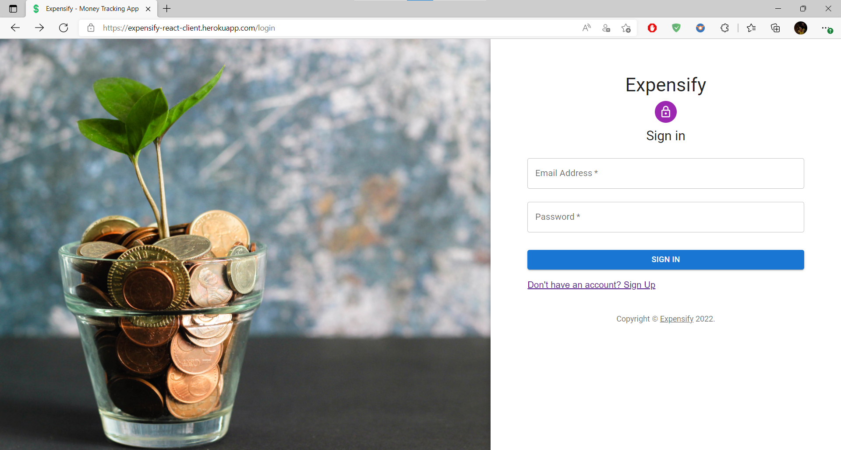

Slide 7
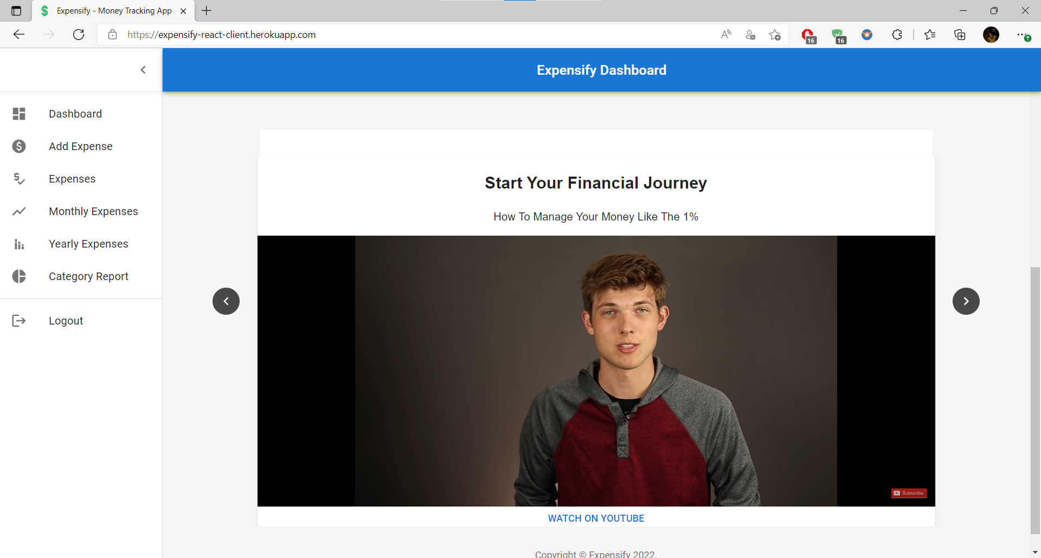

Slide 8
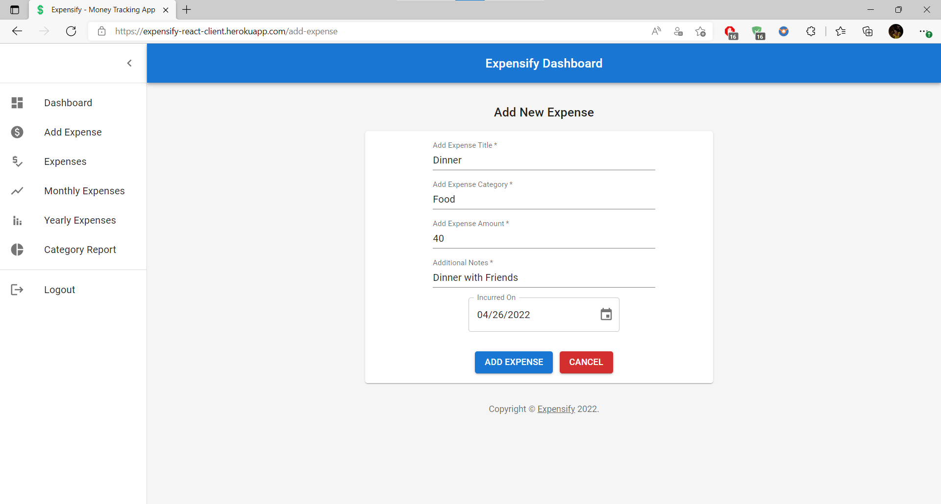

Slide 9
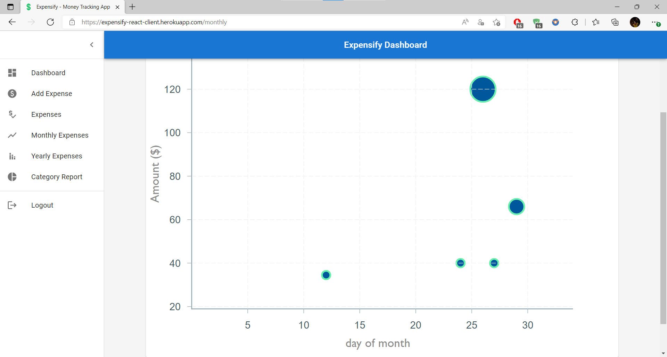

Slide 10
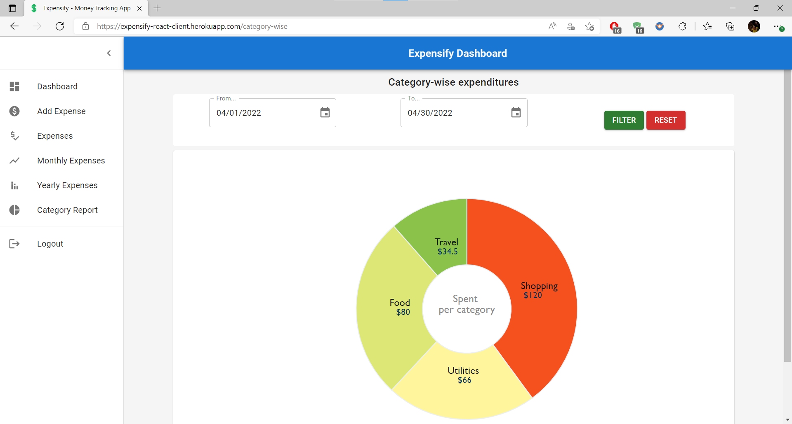

Slide 11
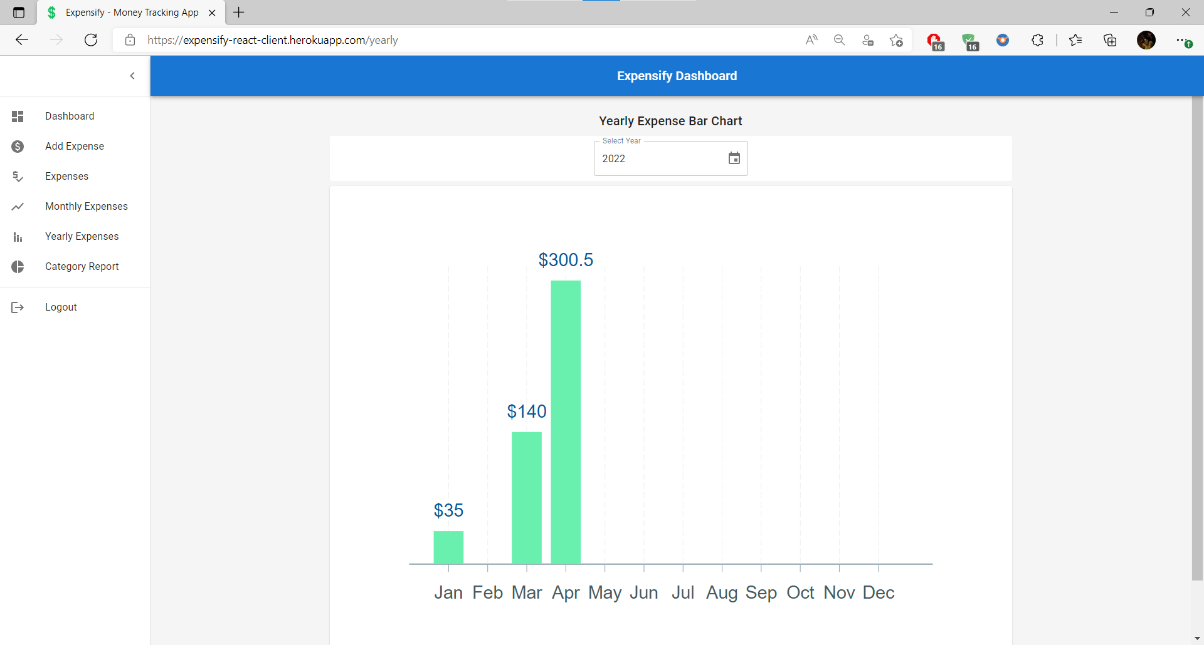

Slide 12
References
https://www.zoho.com/us/expense/expense-reports/
https://developers.google.com/youtube/v3/guides/
https://mui.com/material-ui/getting-started/usage/
https://javascript.info/web-components
https://javascript.info/shadow-dom-events
https://developer.mozilla.org/en-US/docs/Web/CSS/CSS_Grid_Layout
https://plotly.com/
https://www.youtube.com/

